Slide 1


Blockchain functionality summary
Blockchain functionality summary
SoftUni Team
Technical Trainers
Software University
http://softuni.bg

Slide 2
Questions
sli.do #SContracts

Slide 3
Table of Content
Blockchain concept
Consensus
Cryptographic hash functions
Blockchain structures
DApps
Weaknesses
Ethereum
Smart Contracts

Slide 4

A glimpse of the past

Slide 5
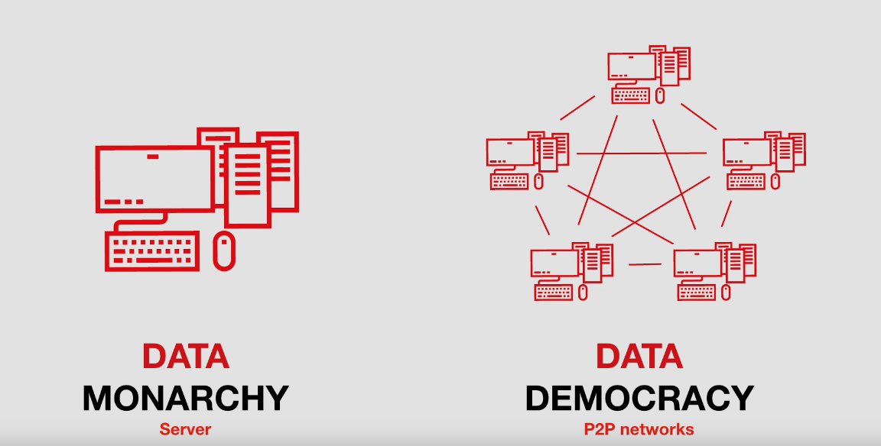

Slide 6


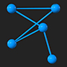

What is a blockchain
A blockchain is a database that is shared across a network of computers.
Once a record has been added to the chain it is very difficult to
change
To ensure all the copies of the database are the same,
the network makes constant checks.
Blockchains have been used to underpin cyber-currencies like bitcoin, but many other possible uses are emerging.

Slide 7


What is a blockchain
Chain
All books
Transaction
Can be any information, a deal for example
Block
Bundle of transactions
Chain
All blocks linked together

Slide 8
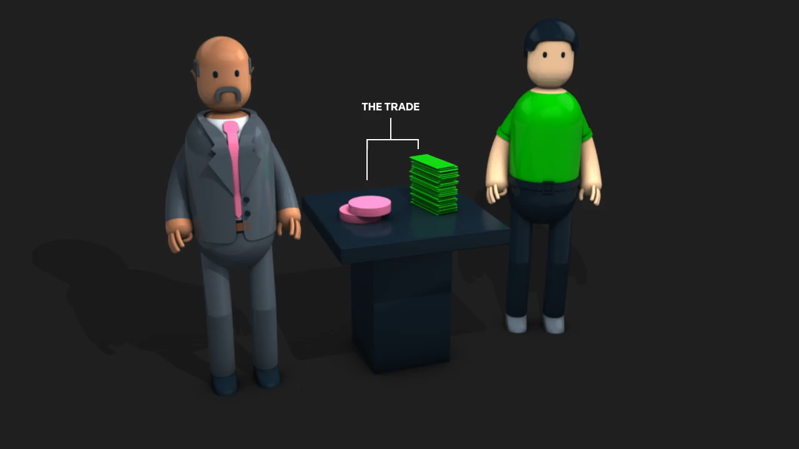
Example – Step 1
Mr. Pink is selling two of his coins to Mr. Green for $100. The record lists the details, including a digital signature from each party.
Chain
All books

Slide 9
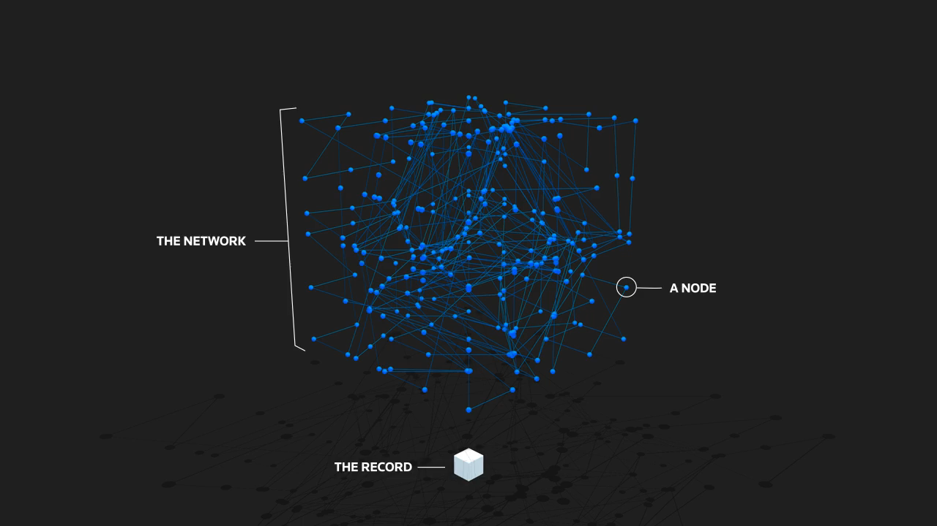
Example – Step 2
The transaction is checked by the network. The computers in the network, called 'nodes', check the details of the trade to make
sure it is valid.
Chain
All books

Slide 10

Example – Step 3
The records that the network accepted are added to a block. Each
block contains a unique code called a hash. It also contains the
hash of the previous block in the chain.
Chain
All books
Transaction
Can be any information, a deal for example
Block
Bundle of transactions
Chain
All blocks linked together

Slide 11
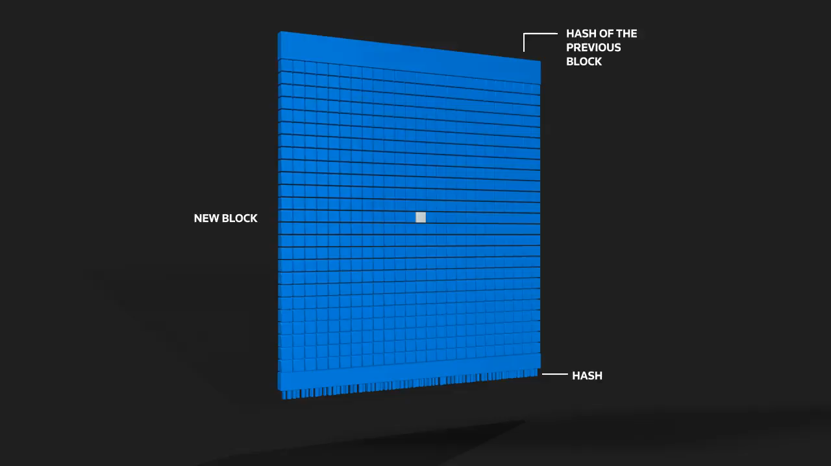
Example – Step 4
The block is added to the blockchain. The hash codes connect the blocks together in a specific order.
Chain
All books
Transaction
Can be any information, a deal for example
Block
Bundle of transactions
Chain
All blocks linked together

Slide 12
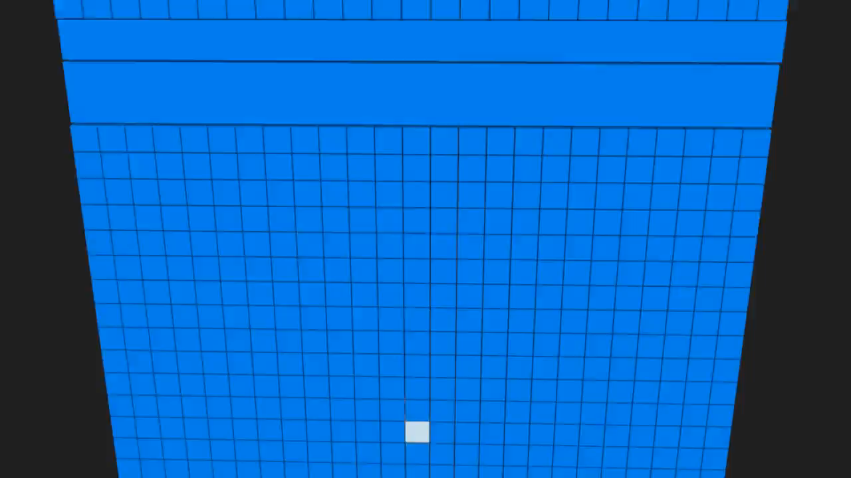
The changed hash breaks the chain.

Slide 13


How blocks are created?
Proof of work
To add a block to the chain, nodes must demonstrate that they have done ‘work’ by solving an increasingly difficult
computational puzzle.
This process, called mining, uses a lot of computing power. In return for their work, members can receive rewards – tokens for instance, or bitcoins.
Proof of Stake
Participants buy tokens which allow them to join the network. The more tokens they have, the more they can mine.

Slide 14

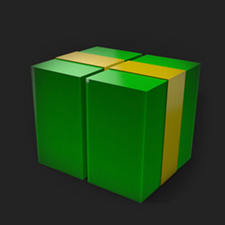

Use cases
Cryptocurrency
Blockchains are the basis of bitcoin and other cryptocurrencies.
Banking
Financial institutions have been investing in blockchains to simplify their record-keeping for payments.
Supply chain
For example, jewelry companies hope it can assure customers that diamonds are not from places where they could finance war.

Slide 15



Use cases
Healthcare
With blockchain, medical history could be securely stored and controlled by patients.
Voting
Blockchain records could create tamper-proof election returns.
Property records
Storing land records on a
blockchain could cut down on costly title research and insurance.

Slide 16
Key characteristics
Distributed ledger
Digital
Updated near real time
Cryptographically sealed
Irreversible and auditable
Operates ‘trustless’
Fewer third parties
Chronological and timestamped

Slide 17
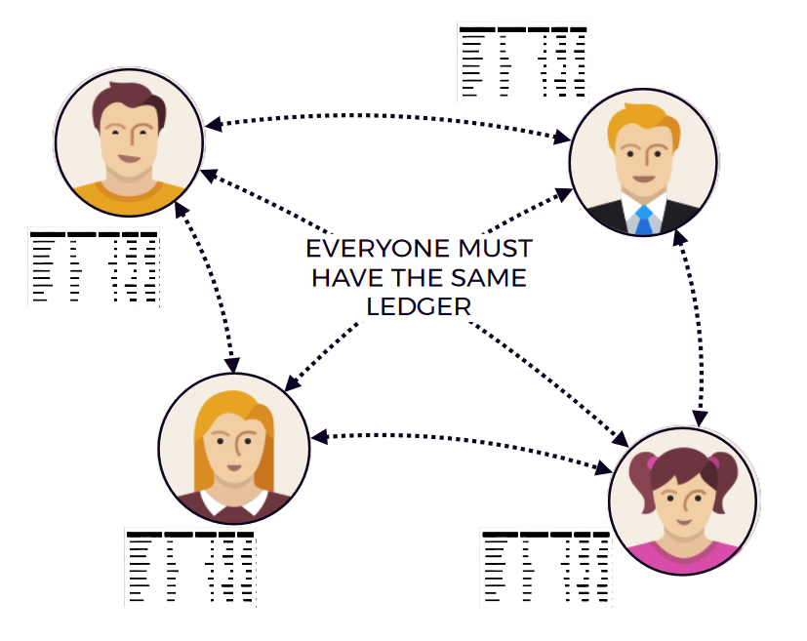
What are consensus mechanisms
Facilitate the agreement
process among participants to
guarantee data consistency

Slide 18
What are consensus mechanisms
“The purpose of a consensus algorithm,
in general, is to allow for the secure
updating of a state according to some
specific state transition rules, where the
right to perform the state transitions is
Distributed among some economic set.”
Vitalik Buterin

Slide 19
What are consensus mechanisms
Everyone must have the
same ledger
Consensus mechanisms
incentivize honesty

Slide 20
What are consensus mechanisms
Different approaches
Practical Byzantine Fault
Tolerance (PBFT)
Proof of work
Proof of stake
And more...
Each mechanism includes rules
to determine what is a valid block

Slide 21

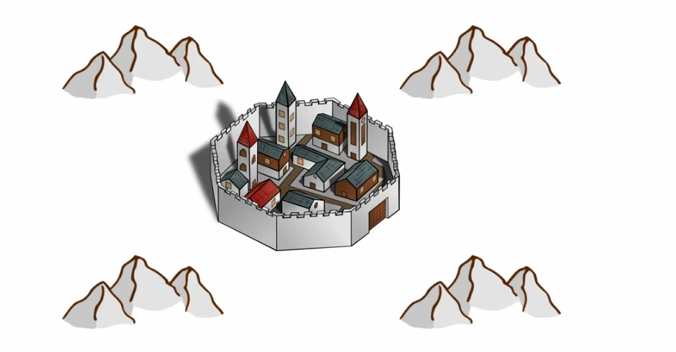




Practical Byzantine Fault Tolerance

Slide 22
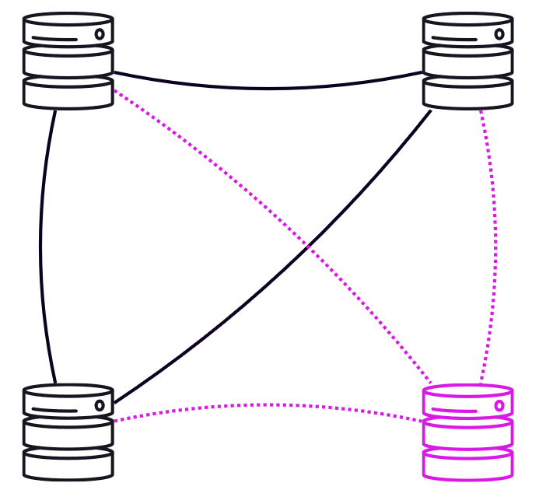
Practical Byzantine Fault Tolerance
Mathematical verification of messages
Tolerates ~⅓ dishonest or absent participants
A functioning network with 1 out of 4
faulty nodes is byzantine fault tolerant
Once agreement is verified, the ledger is
updated

Slide 23
Proof of Work
Rule
Block hash must be less than target number (difficulty)
Miners guess and check hashes
Broadcast solution to the network
Solution includes reward for the miner

Slide 24
Proof of Work
PoW is a competition for the reward
Who can find a valid block hash first?
Ethereum: 15 second block time
Computationally
EXPENSIVE
High energy use

Slide 25
Proof of Stake
Rule
Block validator randomly selected by the network
Chance of selection is proportional to stake
Favors large stake holders

Slide 26
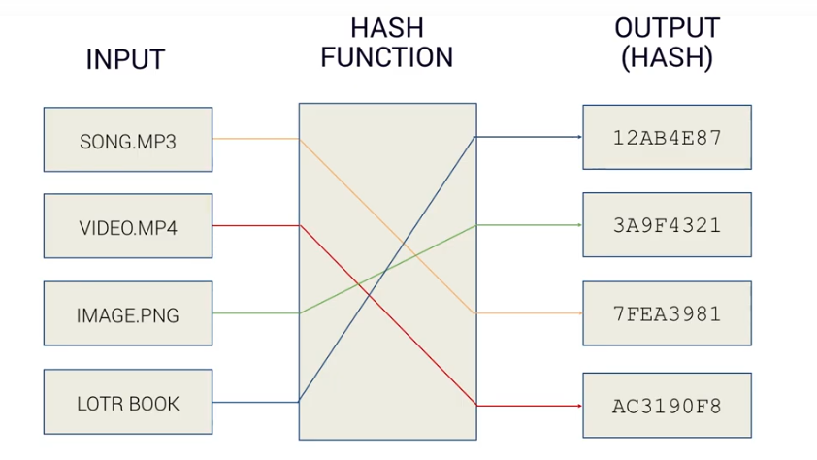
Cryptographic Hash Functions

Slide 27
Cryptographic Hash Functions
Deterministic
Fast
Infeasible to reverse
One-way
Small change in input results in very different output
Collision resistant
Infeasible to find 2 input with the same output

Slide 28
Example
SHA-256 hash of the word "apple" is:
SHA-256 hash of "applf" (incrementing the 'e' to an 'f') is
3a7bd3e2360a3d29eea436fcfb7e44c735d117c42d1c1835420b6b9942dd4f1b
75721aa556fe5e5c8dddd399a7ede960b73b619e96b0db1d7b7482ba3b74fd6f

Slide 29
Accounts
Create a random private key (64 (hex) characters / 256 bits / 32 bytes)
Derive the public key from this private key (128 (hex) characters / 512 bits / 64 bytes)
Derive the address from this public key. (40 (hex) characters/ 160 bits / 20 bytes)

Slide 30
Block Content
Block header
Transactions
List of Uncles headers
Notes:
Decentralized, distributed database
Event driven architecture
Blocks cannot be changed – anything on the blockchain is a confirmed fact
Data in the blockchain is immutable – one can only append to the blockchain

Slide 31
Block Header
parentHash
number
ommersHash
gasLimit
beneficiary
gasUsed
stateRoot
timestamp
transactionsRoot
extraData
receiptsRoot
mixHash
logsBloom
nonce
difficulty
Notes:
parentHash:
The Keccak 256-bit hash of the parent
block’s header
ommersHash:
The Keccak 256-bit hash of the om-
mers list portion of this block
beneficiary:
The 160-bit address to which all fees
collected from the successful mining of this block
be transferred;
stateRoot:
The Keccak 256-bit hash of the root
node of the state trie, after all transactions are
executed and finalisations applied
transactionsRoot:
The Keccak 256-bit hash of the
root node of the trie structure populated with each
transaction in the transactions list portion of the
block
receiptsRoot:
The Keccak 256-bit hash of the root
node of the trie structure populated with the re-
ceipts of each transaction in the transactions list
portion of the block
logsBloom:
The Bloom filter composed from index-
able information (logger address and log topics)
contained in each log entry from the receipt of
each transaction in the transactions lis
difficulty:
A scalar value corresponding to the dif-
ficulty level of this block. This can be calculated
from the previous block’s difficulty level and the
timestamp
number:
A scalar value equal to the number of an-
cestor blocks. The genesis block has a number of
zero
gasLimit:
A scalar value equal to the current limit
of gas expenditure per block
gasUsed:
A scalar value equal to the total gas used
in transactions in this block
timestamp:
A scalar value equal to the reasonable
output of Unix’s time() at this block’s inception
extraData:
An arbitrary byte array containing data
relevant to this block. This must be 32 bytes or
fewer
mixHash:
A 256-bit hash which, combined with the
nonce, proves that a sufficient amount of compu-
tation has been carried out on this block

Slide 32
What is a Merkle Tree?
Features:
Cryptographically authenticated
Changing one piece of data changes the root
Efficiently verify contents
Concisely prove that data is in a set
Requires a limited subset of the tree
Scalability

Slide 33
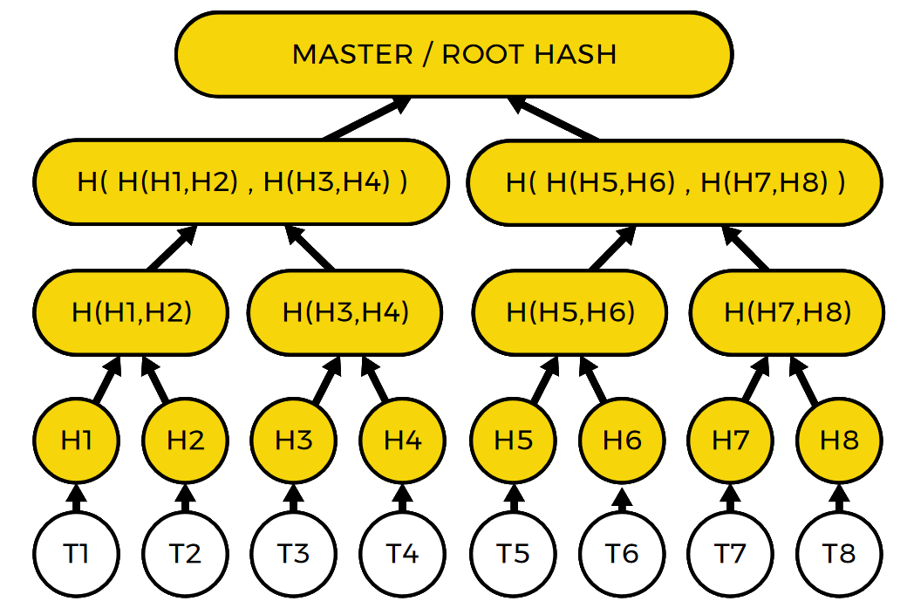
What is a Merkle Tree?
Hash of 2 below hashes
Hash of 2 below hashes
Hash of Transactions (leaves)
Transaction set

Slide 34
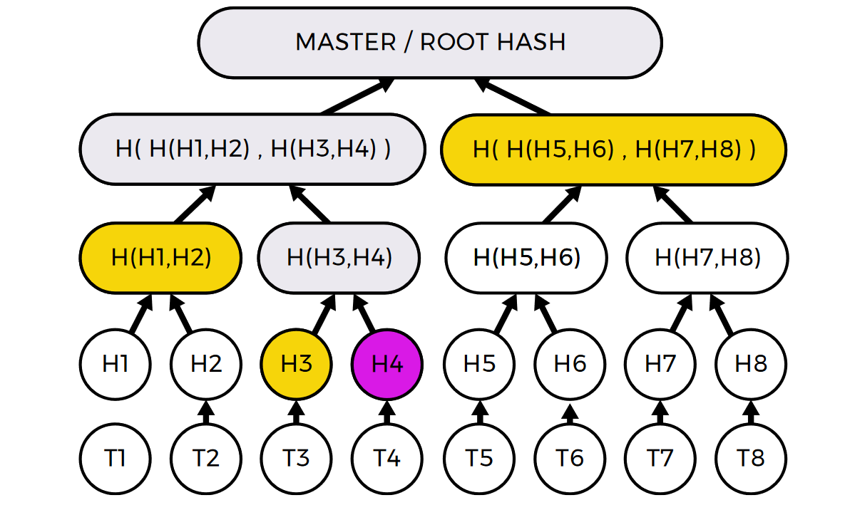
What is a Merkle Tree?

Slide 35
Block Content
Block header
Transactions
List of Uncles headers
Notes:
parentHash:
The Keccak 256-bit hash of the parent
block’s header
ommersHash:
The Keccak 256-bit hash of the om-
mers list portion of this block
beneficiary:
The 160-bit address to which all fees
collected from the successful mining of this block
be transferred;
stateRoot:
The Keccak 256-bit hash of the root
node of the state trie, after all transactions are
executed and finalisations applied
transactionsRoot:
The Keccak 256-bit hash of the
root node of the trie structure populated with each
transaction in the transactions list portion of the
block
receiptsRoot:
The Keccak 256-bit hash of the root
node of the trie structure populated with the re-
ceipts of each transaction in the transactions list
portion of the block
logsBloom:
The Bloom filter composed from index-
able information (logger address and log topics)
contained in each log entry from the receipt of
each transaction in the transactions lis
difficulty:
A scalar value corresponding to the dif-
ficulty level of this block. This can be calculated
from the previous block’s difficulty level and the
timestamp
number:
A scalar value equal to the number of an-
cestor blocks. The genesis block has a number of
zero
gasLimit:
A scalar value equal to the current limit
of gas expenditure per block
gasUsed:
A scalar value equal to the total gas used
in transactions in this block
timestamp:
A scalar value equal to the reasonable
output of Unix’s time() at this block’s inception
extraData:
An arbitrary byte array containing data
relevant to this block. This must be 32 bytes or
fewer
mixHash:
A 256-bit hash which, combined with the
nonce, proves that a sufficient amount of compu-
tation has been carried out on this block

Slide 36
Transaction
nonce
gasPrice
gasLimit
to
value
v, r, s

Slide 37
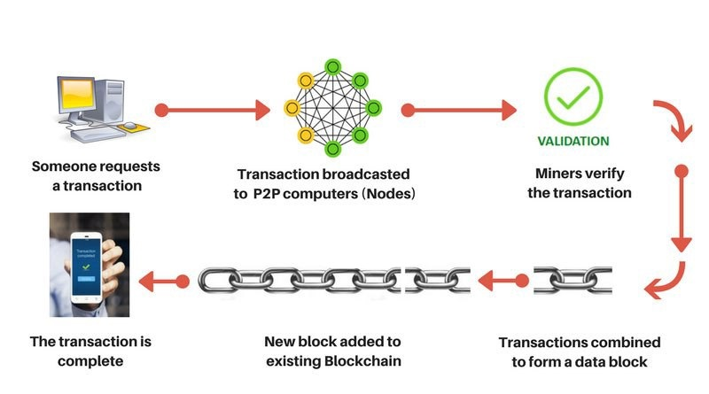
Transaction Flow

Slide 38
Decentralized applications
Back-end code on the blockchain
Decentralized
Autonomous
Immutable
No censorship, control
Peer-to-peer
100% uptime
Notes:
Причината за този рязък скок са децентрализираните приложения.
Те са като сървър с 100% uptime, и никой не може да отиде и да ръгне флашката та да счупи нещата

Slide 39
Weaknesses
scalability / throughput
speed
blockchain size
energy consumption
publicity
human error
politics
51% attack (Kind of fixed by PoS)

Slide 40
Ethereum – the world computer
100% open source platform to build and distribute decentralized applications
no middle men
social sites, financial systems, voting mechanisms, games, reputation systems
100% peer to peer, censorship-proof
all nodes validate the network at all times, coming into consensus
Notes:
Благодарение на Етериум имаме възможността да създаваме технологии, които са децентрализирани премахвайки посредници и позволявайки на потребителите да разменят информация/стойност/услуги/стоки директно. Това намалява таксите и разходите, премахва цензората, предотвратява така нарения single point of failure, осигурява прозрачност и вяра между всички които участват в мрежата.
Етериум е отворена платформа, която е разработена с тази цел – създаването на децетрализирани приложения dApps на кратко.
A smart contract is a blockchain application that runs exactly as it’s programmed — without any third party interference.
Imagine a farmer that buys drought insurance to protect against dry years. One year, a drought hits, and all the crops are dead — completely unsalvageable. When the farmer files an insurance claim, the insurance company might say “We think this was caused by human error. Sorry, not paying.”
The farmer and insurance company then enter a long legal battle, waste money on lawyers, and in the end, the farmer gets way less than their policy called for.
Had the farmer and insurance company entered a smart contract, the contract would be programmed to watch the rain levels in the farm’s area. If rain levels fell below a certain level within a specified period of time, money would automatically be transferred to the farmer’s account. No lawyers hired, no claims filed, no middlemen.
Crypto ventures can use these smart contracts to create their own coins that operate on an “if this then that” structure.

Slide 41
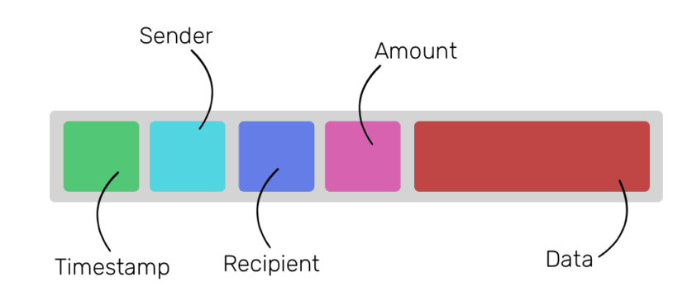
Ethereum transaction

Slide 42
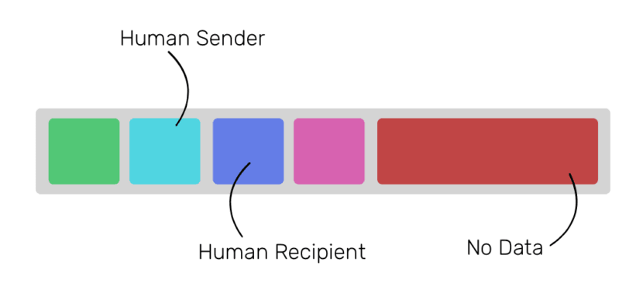
Send Ethers

Slide 43
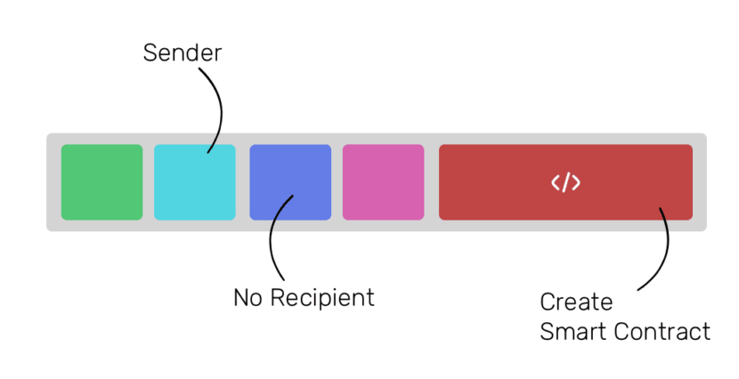
Deploy Smart Contract

Slide 44
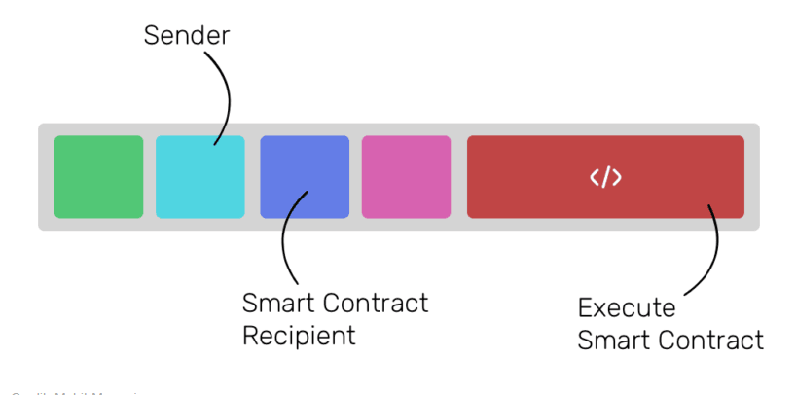
Invoke Smart Contract function

Slide 45



Smart contracts
Execution
Contract
Definition
Audit
Notes:
Благодарение на Етериум имаме възможността да създаваме технологии, които са децентрализирани премахвайки посредници и позволявайки на потребителите да разменят информация/стойност/услуги/стоки директно. Това намалява таксите и разходите, премахва цензората, предотвратява така нарения single point of failure, осигурява прозрачност и вяра между всички които участват в мрежата.
Етериум е отворена платформа, която е разработена с тази цел – създаването на децетрализирани приложения dApps на кратко.
A smart contract is a blockchain application that runs exactly as it’s programmed — without any third party interference.
Imagine a farmer that buys drought insurance to protect against dry years. One year, a drought hits, and all the crops are dead — completely unsalvageable. When the farmer files an insurance claim, the insurance company might say “We think this was caused by human error. Sorry, not paying.”
The farmer and insurance company then enter a long legal battle, waste money on lawyers, and in the end, the farmer gets way less than their policy called for.
Had the farmer and insurance company entered a smart contract, the contract would be programmed to watch the rain levels in the farm’s area. If rain levels fell below a certain level within a specified period of time, money would automatically be transferred to the farmer’s account. No lawyers hired, no claims filed, no middlemen.
Crypto ventures can use these smart contracts to create their own coins that operate on an “if this then that” structure.

Slide 46


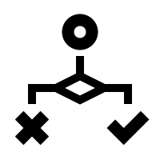

Abilities
Data storage
Logic
ETH Balance
Multicontract interaction

Slide 47
pragma solidity >=0.4.22 <0.6.0;
contract HelloWorld {
function renderHelloWorld ()
public
pure
returns (string memory) {
return “HelloWorld”;
}
}

Slide 48

Do you really need a crypto contract?

Slide 49
Smart contract applications
voting
freedom of speech
social networks
crowdfunding
token currencies
resource sharing
replace of intermediary

Slide 50

The DAO attack
June 17, 2016
Vulnerability in the DAO
Hacker drained $53M
Resulted in Hard fork

Slide 51
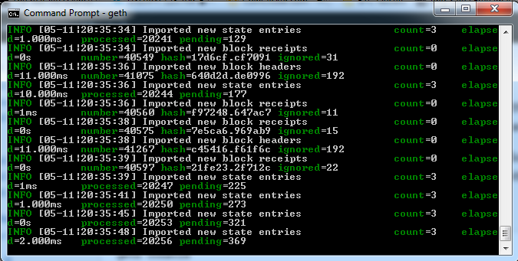
Sep 19, 2016 DOS attack
Vulnerability in GETH
Caused a global crash
During devcon2
Notes:
This is due to the EXTCODESIZE opcode, which has a fairly low gasprice but which requires nodes to read state information from disk; the attack transactions are calling this opcode roughly 50,000 times per block. The consequence of this is
that the network is greatly slowing down, but there is NO consensus failure or memory overload. We have currently identified several routes for a more sustainable medium-term fix and have developers working on implementation.

Slide 52
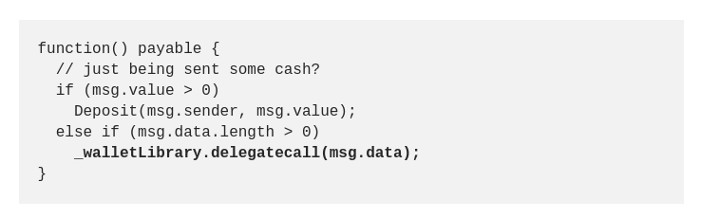
Parity Multi-sig wallet hack
Jul 19, 2017
Vulnerability in Parity’s Multi-sig wallet
150,000 ETH Stolen (~$30M at the time) - Never returned
Aeternity suffered major loss

Slide 53

Cryptokitties

Slide 54
Interesting content
https://ethereum.github.io/yellowpaper/paper.pdf
http://hackingdistributed.com/2016/06/18/analysis-of-the-dao- exploit/
https://blog.ethereum.org/2015/11/15/merkling-in-ethereum/

Slide 55
https://softuni.bg/trainings/courses

Slide 56











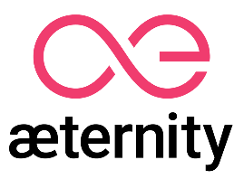

SoftUni Diamond Partners

Slide 57





SoftUni Organizational Partners

Slide 58




Trainings @ Software University (SoftUni)
Software University – High-Quality Education and Employment Opportunities
softuni.bg
Software University Foundation
http://softuni.foundation/
Software University @ Facebook
facebook.com/SoftwareUniversity
Software University Forums
forum.softuni.bg

Slide 59

License
This course (slides, examples, demos, videos, homework, etc.) is licensed under the "Creative Commons Attribution-NonCommercial-ShareAlike 4.0 International" license

